Slide 1
Employee Health Scheme
How to use EHS Application
(USER MANUAL)

Slide 2
Contents
Application URL
Select EHS dependent
Prescribe Medicines
  Add
    Add available medicine in EHS Pharmacy stock
    Add medicine/branded medicine not available in EHS Pharmacy stock
  Save
  Print
Add medicine not listed/cannot be searched
Edit/Delete Prescription
Repeat Prescription
Surgical Items
Issues? Contact us

Slide 3
Access EHS Application [Screenshot on next Page]
Application works in Mozilla Browser only
Type URL 192.168.15.4 and press Enter for Intranet (LAN) users
Type URL 14.139.245.52 and press Enter for Internet users
Login with your user id and password

Slide 4
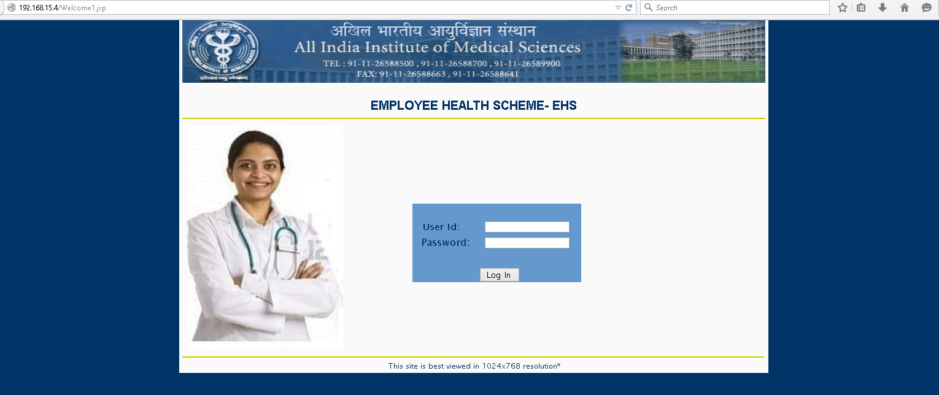
Access EHS Application

Slide 5
Select EHS dependent [Screenshot on next Page]
Select EHS Id and click on the right side small icon to select the EHS dependent for whom you want to prescribe medicines.
Name will show up in Patient Name column.
Write Diagnosis in the text area.
Click on Save and Next button at the bottom of page to proceed further.

Slide 6
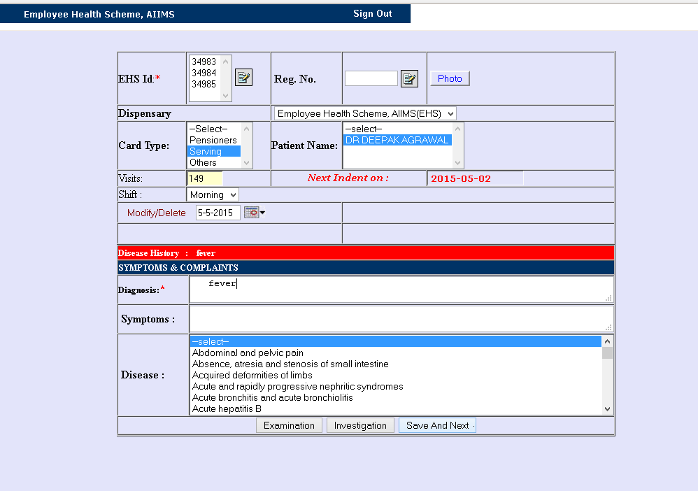
Select EHS dependent

Slide 7
Prescribe Medicines – Add available medicine in EHS Pharmacy stock
Click on Medicine Button on top of the page, it will show all available medicines in EHS stock, Add by clicking on ADD button.
OR
Type medicine name in the search box (minimum 3 characters) and press Tab on the keyboard.
  Search result in Green color shows that substitute of the medicine is available in EHS Pharmacy stock but available substitute strength, type, brand may differ.
  Search result in Black color shows that medicine or its substitute is not available in EHS Pharmacy stock and if selected, will be sent for LP.

Slide 8
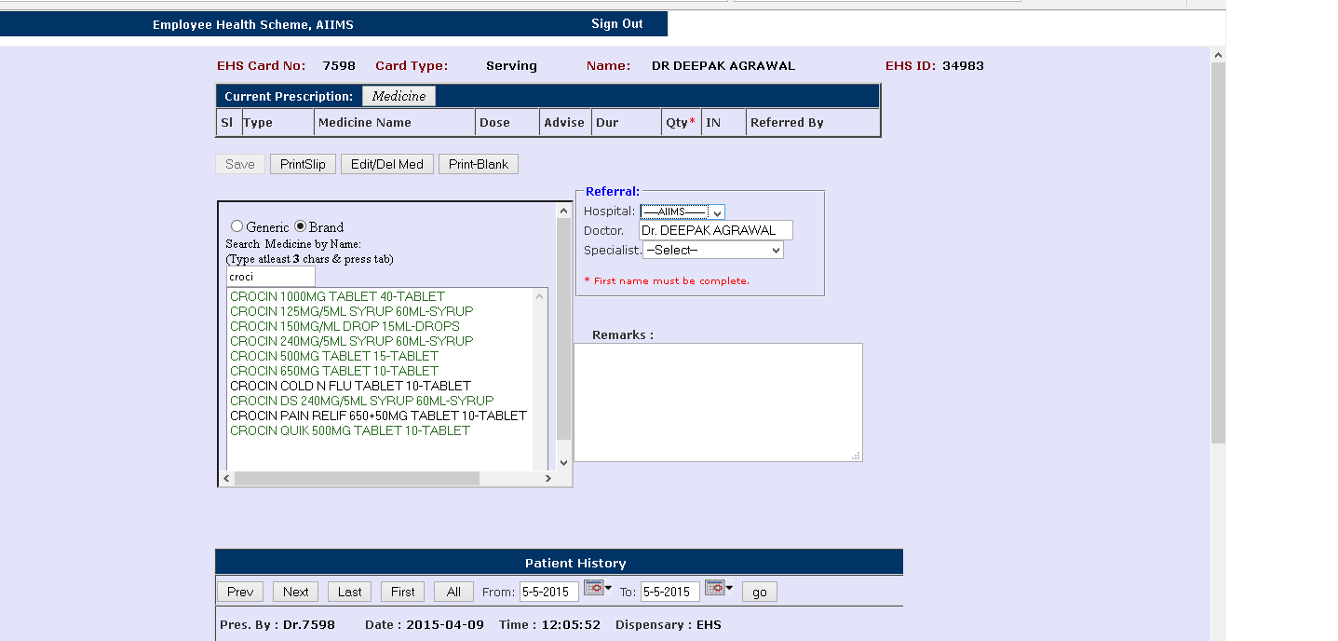
Prescribe Medicines – Add available medicine in EHS Pharmacy stock

Slide 9
Prescribe Medicines – Add available medicine in EHS Pharmacy stock [Screenshot on next Page]
Click on the search result in Green colour to see the substitute available in EHS Pharmacy Stock.
Add medicine by clicking on the Add button.

Slide 10
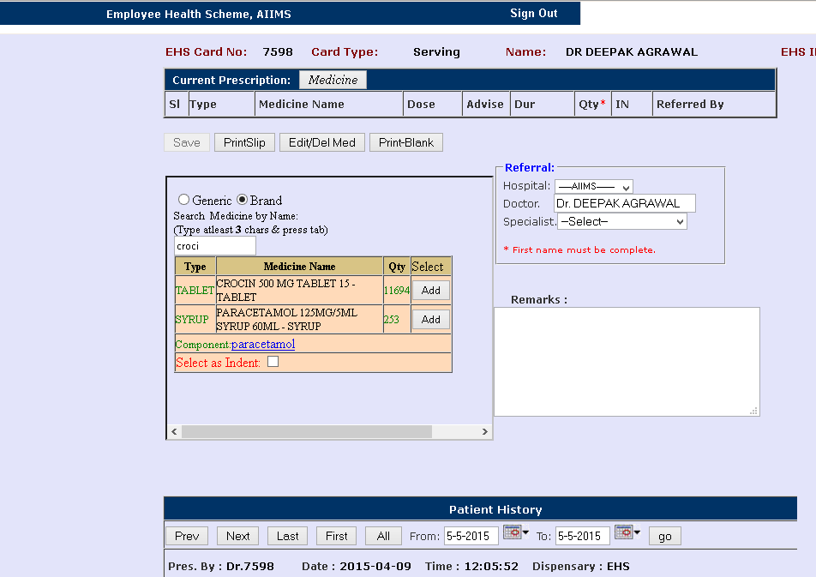
Prescribe Medicines – Add available medicine in EHS Pharmacy stock

Slide 11
Prescribe Medicines – Add medicine/branded medicine not available in EHS Pharmacy Stock [Screenshot on next Page]
Type medicine name in the search box (minimum 3 characters) and press Tab on the keyboard.
  Search result in Green color shows that substitute of the medicine is available in EHS Pharmacy stock but available substitute strength, type, brand may differ.
  Search result in Black color shows that medicine or its substitute is not available in EHS Pharmacy stock and if selected, will be sent for LP.

Slide 12
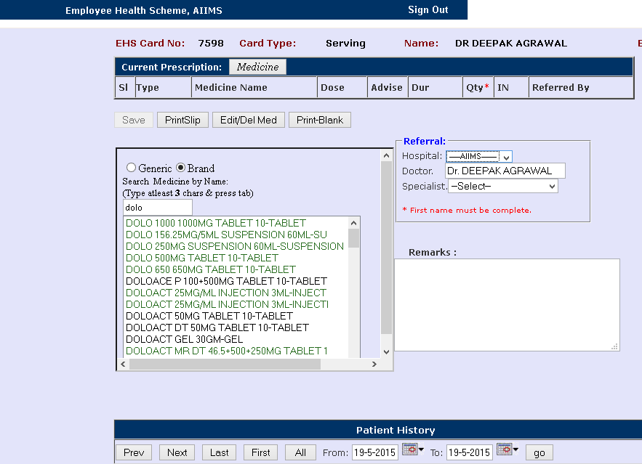
Prescribe Medicines – Add medicine/branded medicine not available in EHS Pharmacy Stock

Slide 13
Prescribe Medicines – Add medicine/branded medicine not available in EHS Pharmacy Stock [Screenshot on next Page]
Click on the desired medicine name. If substitute of the medicine is available than this will appear on screen.
If substitute is not desired than Click on ‘Select as Indent’ or ‘Keep Original’ to add selected medicine as LP (Local Purchase). Please provide justification in the Remarks column why substitute is not desired.

Slide 14
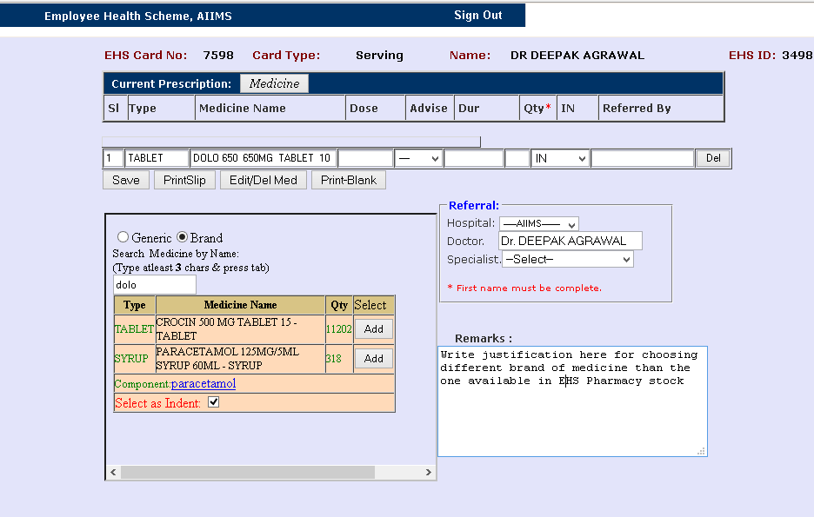
Prescribe Medicines – Add medicine/branded medicine not available in EHS Pharmacy Stock

Slide 15
Prescribe Medicines – Save [Screenshot on next Page]
Search, Select and Add the medicines one by one
Fill quantity required against each medicine
Click on Save button to Save the medicines
Saved medicines will be reflected in Patient History at the bottom

Slide 16
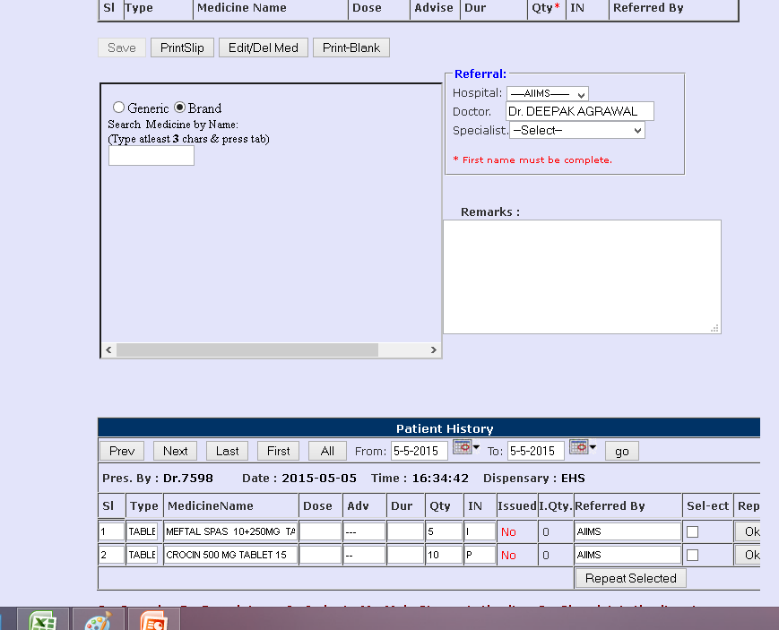
Prescribe Medicines – Save

Slide 17
Prescribe Medicines – Print [Screenshot on next Page]
Click on Print Slip to take the print out of the medicines prescribed. This option will be applicable for printing on same day.
    OR
Click on the go button in Patient History to take the print out of the medicines prescribed.
Please note that Print outs are valid up to 4 days after prescription including date of prescription.
Please sign and stamp the print out and send it to EHS Pharmacy

Slide 18
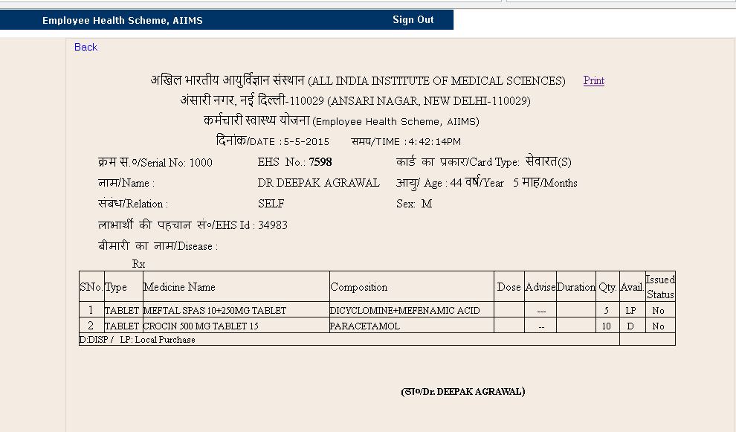
Prescribe Medicines – Print

Slide 19
    Add medicine – Not Listed / Cannot be searched [Screenshot on next Page]
Click On Add Request medicine in Menu Bar
Enter Brand Name/Medicine Name that is not found during search
Fill in details about the medicine viz. Salt name, Type, Strength and click on Add Request button
Medicine will be added after due verification

Slide 20
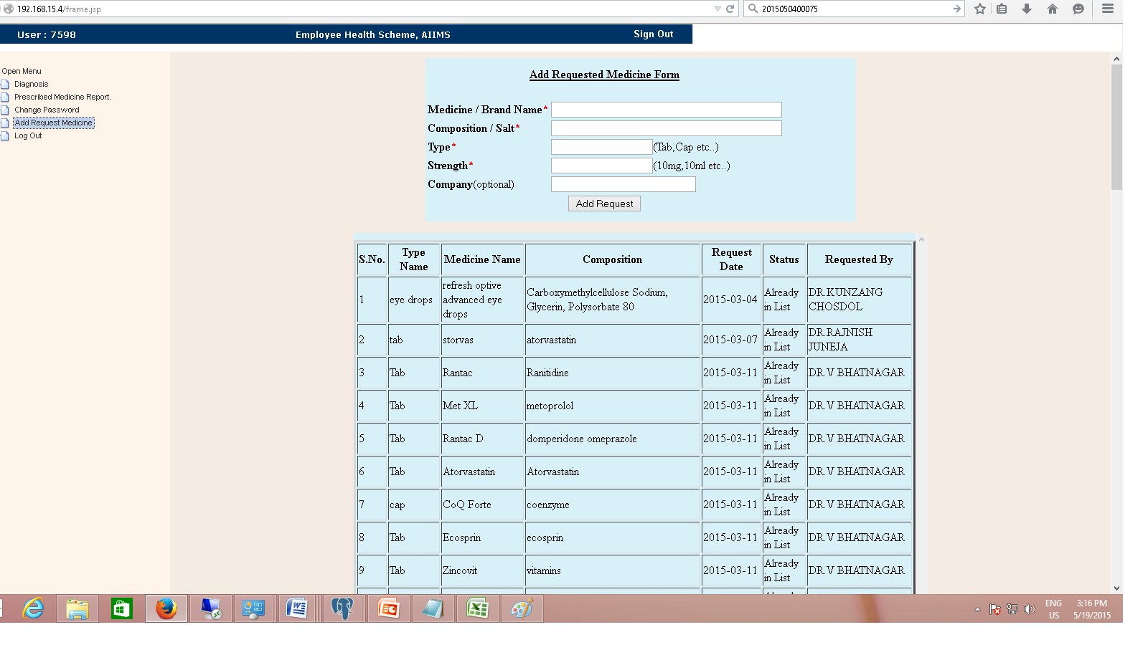
    Add medicine – Not Listed / Cannot be searched

Slide 21
Edit/Delete Prescription [Screenshot on next Page]
You can Edit Prescription on same day before it is sent to EHS Pharmacy for Issue
Click on Edit/Del Med button, Edit and Delete Medicines dialog box will open.
You can edit the quantity required by changing the quantity and clicking on Save Changes
You can delete medicine by selecting the checkbox under Click to Delete. Please note that LP medicines cannot be deleted, their quantity can be set to zero.

Slide 22
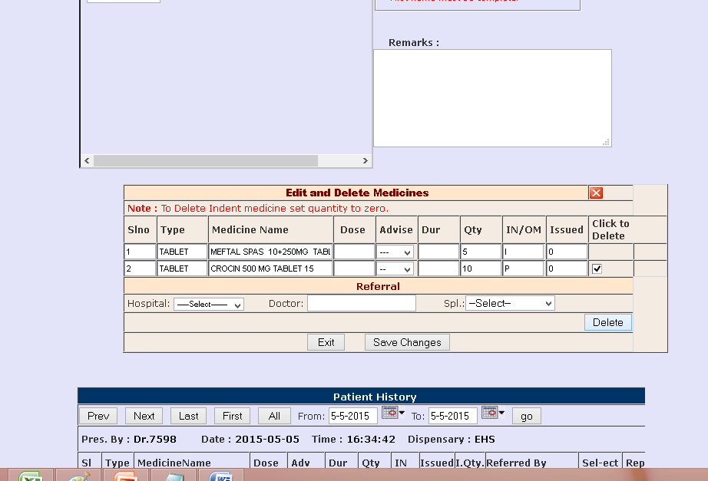
Edit/Delete Prescription

Slide 23
Repeat Prescription [Screenshot on next Page]
At the bottom of the medicine prescription page, there is Patient History. Go to previous prescribed medicine list by clicking on Prev button.
Repeat medicine one by one by clicking on Ok button
Select the medicines you want to repeat by clicking on checkboxes and click on Repeat Selected button

Slide 24
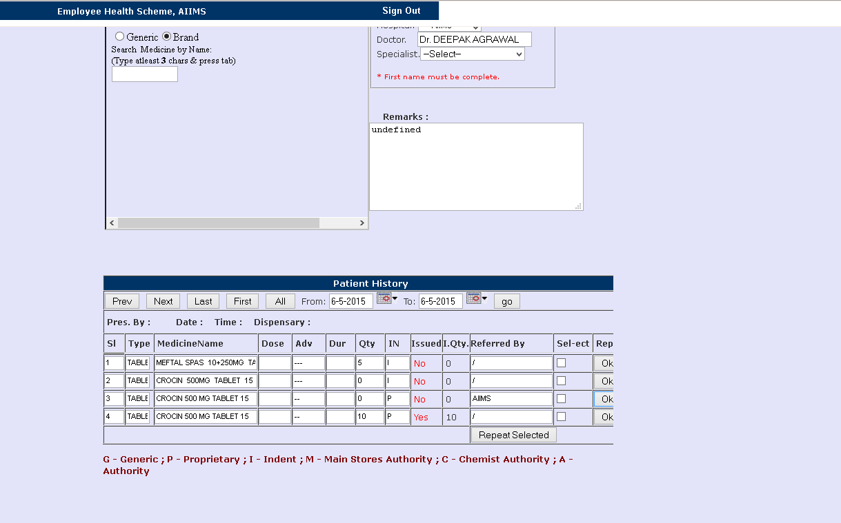
Repeat Prescription

Slide 25
Surgical Items
Click on Print Blank Button on the medicine prescription page to print blank slip and write surgical items needed in the slip and send it to EHS OPD.
Please note that above process of writing Surgical items will be changed w.e.f 1-Jun-15.

Slide 26
Issues? Contact us
If medicine desired is not found in the search box than you can send request to add medicine by clicking on link Add Request Medicine in Menu Bar
Medicine will be added after approval
For any suggestions/feedback, mail to: ehspharmacy@gmail.com
For any assistance, contact Vivek: 9868418977

